Slide 1
Analyzing biodiversity through data
Codecademy final project

Slide 2
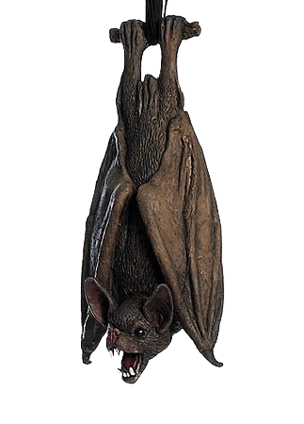
Biodiversity in animals

Slide 3
Key questions
What is the distribution of unique species according to genus? What about according to animal type (mammal, amphibian, etc) ?
How does conservation status differ between animal types?
Which genus’ contain the largest number of endangered species?
Are differences between species and their conservation status statistically significant?

Slide 4
General objectives
Compare number of unique species based on animal type, genus, and other variables.
Compare conservation status based on animal type and genus. Explore which genus’ contain the largest and smallest number of highly endangered species.
Create a function that compares the most endangered species given animal type or genus.
Explore whether differences between species and their conservation status are statistically significant.

Slide 5
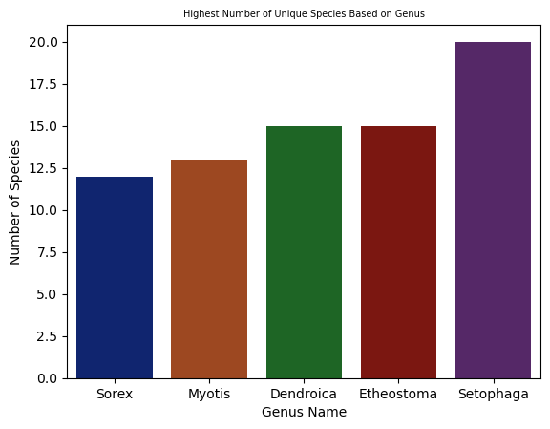
Understanding unique
The average number of unique species per genus is 2.2. However, the Setophaga genus contains the highest number of unique animals when compared to all other genus's, with a total of twenty unique species.

Slide 6
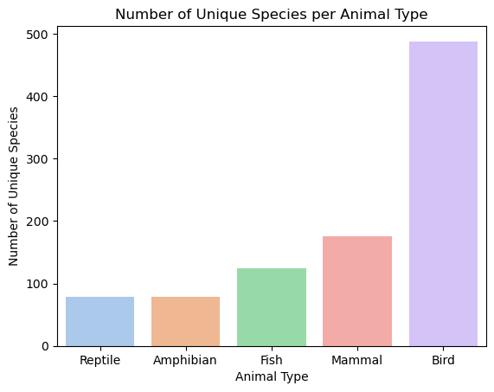
Understanding unique (cont.)
By far, birds contain the highest number of unique animal species at five hundred, which is more than twice than that of mammals. This is much higher than the average for each animal type, which is 189.2 unique species.

Slide 7
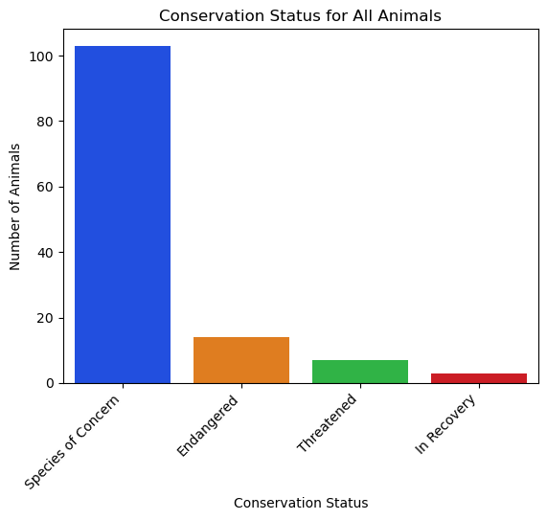
Concerning conservation
The most prevalent conservation status among all animals are by far Species of Concern, with Endangered following at a distant second and Threatened at third.

Slide 8
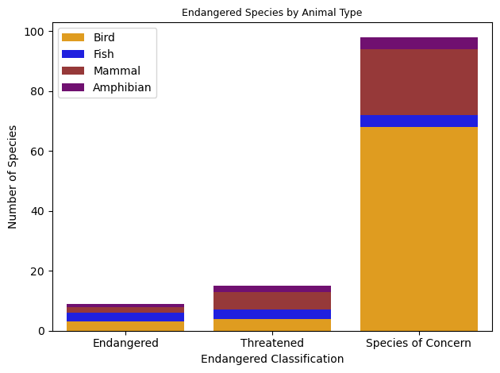
Concerning conservation (cont.)

Slide 9
Concerning conservation (cont.)
Category | Not Protected | Protected | Percent Protected
Amphibian | 7 | 72 | 91.1%
Bird | 75 | 413 | 84.6%
Fish | 10 | 115 | 92.0%
Mammal | 30 | 146 | 83.0%
Reptile | 5 | 73 | 93.6%
Amongst mammals, some of the most highly endangered species (Endangered of Threatened) include the Canis Lupus (Gray Wolf), Canis Rufus (Red Wolf), Myotis Grisescens (Indiana Bat), and Sabrinus Coloratus (Carolina Northern Flying Squirrel).

Slide 10
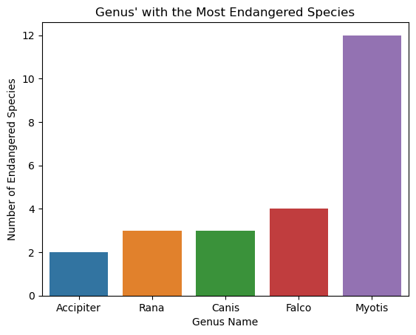
Concerning conservation (cont.)
The Myotis genus contains the largest number of highly endangered species (Endangered of Threatened). These include the Myotis Grisescens (Gray Myotis), Myotis Sodalis (Indiana Bat), and Myotis Septentrionalis (Northern Long-Eared Bat).

Slide 11
Conclusions
Although the Myotis Genus contains the fourth highest number of unique species, it also contains the largest number of highly endangered species by far.
Mammals belonging to the Myotis genus (bats) compose a significant portion of endangered animals in the mammal category.
The Falco genus contains the second highest number of endangered species. However, there are many other endangered species spread among other bird genus’s, most of which are listed as Species of Concern.
Reptiles contain the least amount of endangered species, and contain no highly endangered species.
it can be said that mammals have a statistically higher rate of needed protection when compared to reptiles. Thus, some species are more likely to be endangered than others.
Conservationists should make sure to dedicate additional efforts and resources into preserving both birds and mammals, given that nearly 20% are under some form of protection. This hold especially true for bats among mammals and falcons among birds.

